Slide 1
SQL Server
25-10-2021
Day 1

Slide 2
Objectives
DBMS
RDBMS
Normalization.

Slide 3
Database
The database is a collection of inter-related data which is used to retrieve, insert and delete the data efficiently. It is also used to organize the data in the form of a table, schema, views, and reports, etc.

Slide 4
DBMS
A database management system (DBMS) refers to the technology for creating and managing databases. DBMS is a software tool to organize (create, retrieve, update, and manage) data in a database.
Database systems are meant to handle an extensive collection of information. Management of data involves both defining structures for storage of information and providing mechanisms that can do the manipulation of those stored information.

Slide 5
DBMS
Database management system is a software which is used to manage the database.
For example: MySQL, Oracle, etc are a very popular commercial database which is used in different applications.
DBMS provides an interface to perform various operations like database creation, storing data in it, updating data, creating a table in the database and a lot more.
It provides protection and security to the database. In the case of multiple users, it also maintains data consistency.

Slide 6
Why DBMS?
To develop software applications In less time.
Data independence and efficient use of data.
For uniform data administration.
For data integrity and security.
For concurrent access to data, and data recovery from crashes.
To use user-friendly declarative query language.

Slide 7
Where DBMS being used?
Airlines: reservations, schedules, etc
Telecom: calls made, customer details, network usage, etc
Universities: registration, results, grades, etc
Sales: products, purchases, customers, etc
Banking: all transactions etc
Ecommerce: Online Shopping

Slide 8
Components of DBMS
Users: Users may be of any kind such as DB administrator, System developer, or database users.
Database application: Database application may be Departmental, Personal, organization's and / or Internal.
DBMS: Software that allows users to create and manipulate database access,
Database: Collection of logical data as a single unit.

Slide 9
3 Tier Architecture
A 3-tier application is an application program that is structured into three major parts; each of them is distributed to a different place or places in a network. These three divisions are as follows:
The workstation or presentation layer
The business or application logic layer
The database and programming related to managing layer

Slide 10
RDBMS
RDBMS stands for Relational Database Management Systems..
All modern database management systems like SQL, MS SQL Server, IBM DB2, ORACLE, My-SQL and Microsoft Access are based on RDBMS.
It is called Relational Data Base Management System (RDBMS) because it is based on relational model introduced by E.F. Codd.

Slide 11
RDBMS
Data is represented in terms of tuples (rows) in RDBMS.
Relational database is most commonly used database. It contains number of tables and each table has its own primary key.
Due to a collection of organized set of tables, data can be accessed easily in RDBMS

Slide 12
RDBMS
What is table?
The RDBMS database uses tables to store data. A table is a collection of related data entries and contains rows and columns to store data.
A table is the simplest example of data storage in RDBMS.
Field → Field is a smaller entity of the table which contains specific information about every record in the table. In the above example, the field in the student table consist of stId, stName, stAge, stAddress.
stId | stName | stAge | stAddress
101 | Bhushan | 36 | India
102 | Junaid | 25 | India

Slide 13
RDBMS
Row or Record
A row of a table is also called record. It contains the specific information of each individual entry in the table. It is a horizontal entity in the table.

Slide 14
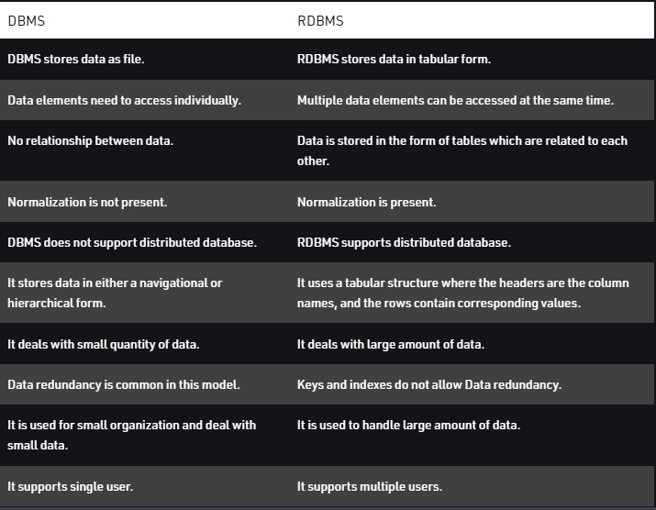

Slide 15
Normalization
Normalization is the process of organizing the data in the database.
Normalization is used to minimize the redundancy from a relation or set of relations.
Normalization divides the larger table into the smaller table and links them using relationship.
The normal form is used to reduce redundancy from the database table.

Slide 16
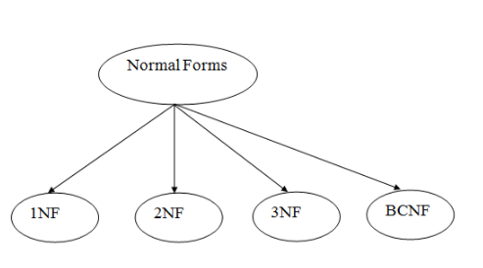
Normalization

Slide 17
Normalization
First Normal Form (1NF)
A relation will be 1NF if it contains an atomic value.
It states that an attribute of a table cannot hold multiple values. It must hold only single-valued attribute.
First normal form disallows the multi-valued attribute, composite attribute, and their combinations.

Slide 18
Normalization
First Normal Form (1NF)
stId | stName | stAge | stAddress | stPhone
101 | Bhushan | 36 | India | 9975665249, 7709134676
102 | Junaid | 25 | India | 7372737276, 5678232627
stId | stName | stAge | stAddress | stPhone
101 | Bhushan | 36 | India | 9975665249
101 | Bhushan | 36 | India | 7709134676
102 | Junaid | 25 | India | 7372737276
102 | Junaid | 25 | India | 5678232627

Slide 19
Normalization
Second Normal Form (2NF)
In the 2NF, relational must be in 1NF.
In the second normal form, all non-key attributes are fully functional dependent on the primary key
In this table stAge and stPhone is associated with stId
stId | stName | stAge | stAddress | stPhone
101 | Bhushan | 36 | Mumbai | 9975665249
101 | Bhushan | 36 | Mumbai | 7709134676
102 | Junaid | 25 | Hyderabad | 7372737276
102 | Junaid | 25 | Hyderabad | 5678232627

Slide 20
Normalization
After implementing second normal form
stId | stAge
101 | 36
102 | 25
stId | stPhone
101 | 9975665249
101 | 7709134676
102 | 7372737276
102 | 5678232627

Slide 21
Normalization
Third Normal Form- Third normal form applies that every non-prime attribute of table must be dependent on primary key, or it shouldn’t be happen that non-prime attribute is determined by other non-prime attribute. (It should qualify second normal form first)
St_ID | St_Name | St_Dob | St_City | St_State | St_Zip

Slide 22
normalization
Here we can see for St_name and St_DOb, St_Id can be primary key but for St_City and St_State St_Zip can be primary key but here in above table it’s non-prime so it can’t qualify third normal form. So we will create a new Table in which St_Zip will be primary key.
Here are two tables to achieve Third normal form.
St_ID | St_Name | St_Dob
St_Zip | St_City | St_State

